Slide 1
MSc AI for marketing strategy
Project Management seminar
Session #3
Robert Fonteijn

Slide 2
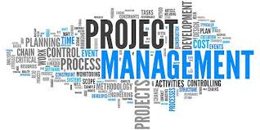
Agenda for Session 3
What do you remember of last Wednesday ?
The A-Z
Work breakdown structure
Gantt charts
Introduction to Quality
Transition to change management

Slide 3
Work for Friday: the A-Z of project management
Subject Agile etc. | What is it? Is the definition clear? Are there alternative definitions? Do some additional research. | Why are we interested? What is the relevance of this subject for project managers ? Give concrete examples for your project, specific business sectors or companies. | How can we use this in practice? What do we think of this subject? How can we apply it in our professional or personal lives ?

Slide 4
Reminder: Project Management : a 3-Phase Approach
Phase I: Build a Business Case
Phase II: Initiate the Project
Phase III: Define & Imple-ment the Project Plan
Business opportunity & suggested solution
Project objectives, scope & approach
Project deliverables & business outcomes
Strategic alignment
Dependencies & constraints
Risk assessment & mitigation
Change impact assessment
Project costs
Benefits
Net present value
Key success factors & KPIs
Project charter
Project challenges and key success factors
RACI matrix
Stakeholder analysis
High-level project plan
Detailed project plan
Project dashboard
Parking lot
Punch list
Post project evaluation report

Slide 5
Later today: Change Management : a 4-phase approach
Phase I: Define the Change Mgt Strategy
Phase II: How people experience change
Phase III: Develop the Change Management Plans
Phase IV: Implement, Track & Manage Progress
Company’s strategy
Required change to implement the strategy
Business roadmap
Company readiness for change
Structure and size of change mgt team
Roles & responsibilities
Guiding principles
Change Lean Canvas
Change impact assessment
Objectives and levers (ADKAR Model)
Change Commitment Curve
Change Personal Transition Curve
Heart & Mind Human Drivers
Innovation Adoption Curve
Maslow Hierarchy of Human Needs
Four Stages of Team Development
Stakeholder analysis
Overarching change management plan
Communication plan
Sponsorship plan
Coaching plan
Training plan
Resistance management plan
Governance
Overarching change management plan status report
Communication plan status report
Sponsorship plan status report
Coaching plan status report
Training plan status report
Resistance management plan status report
Change reinforcement

Slide 6
Agenda for Session 3
What do you remember of last Wednesday ?
The A-Z
Work breakdown structure
Gantt charts (did we cover this?)
Introduction to Quality
Transition to change management

Slide 7
Work Breakdown Structure
Purpose:
Subdivide a complicated task into smaller tasks until you reach
a level that cannot be further subdivided. You’re going from meso to micro. Use a tree structure (arborescence).
Exercise: in teams:
Do a WBS for « Finding sponsors ».

Slide 8
Work Breakdown Structure
Technical requirements of a WBS:
As many levels as you can.
MECE: each line is Mutually Exclusive & Collectively Exhaustive.

Slide 9
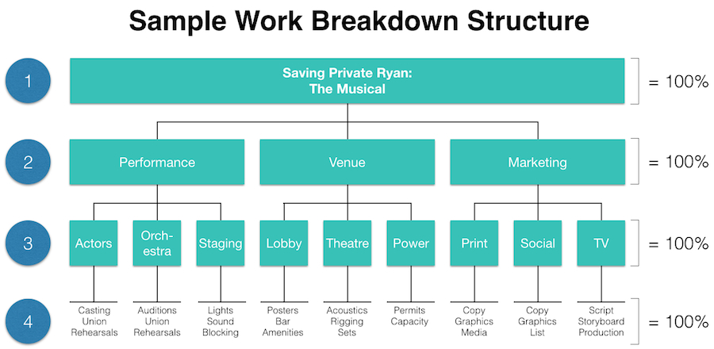

Slide 10





Exercise – in teams
Please draw up a WBS for your project.
15’

Slide 11
Agenda for Session 3
What do you remember of last Wednesday ?
The A-Z
Work breakdown structure
Gantt charts
Introduction to Quality
Transition to change management

Slide 12
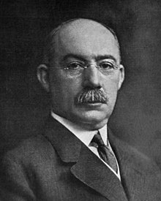
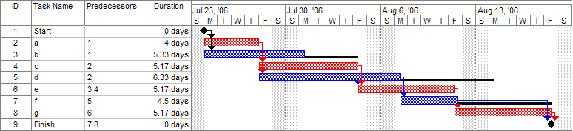
Gantt charts
A Gantt chart is a type of bar chart that illustrates a project schedule. Thes chart lists the tasks to be performed on the vertical axis, and time intervals on the horizontal axis. The width of the horizontal bars in the graph shows the duration of each activity.
Critical path is in red. Slack is in black.

Slide 13
Vocabulary: CPM and PERT
The critical path method (CPM), or critical path analysis (CPA), is an algorithm for scheduling a set of project activities.
It is commonly used together with the programme evaluation and review technique (PERT).
A critical path is determined by identifying the longest stretch of dependent activities and measuring the time required to complete them from start to finish.

Slide 14
Exercise – in teams
Please draw up the GANTT chart for your project.
20’

Slide 15
Agenda for Session 3
What do you remember of last Wednesday ?
The A-Z
Work breakdown structure
Gantt charts
Introduction to Quality
Transition to change management

Slide 16
Quality: vocabulary
Four main components: quality planning, assurance, control and improvement.
“Method-focused” - focus not only on product and service quality as an end result, but very much on the means to achieve it, the methods.
“Fit for purpose” – quality it is a written or unwritten commitment to a known or unknown consumer in the market. Thus, quality can be defined as fitness for intended use or, in other words, how well the product performs its intended function(s).

Slide 17
Main Quality methods
ISO
Kaizen
Six Sigma
Toyota Production System (or: « Lean manufacturing »)
TQM

Slide 18
Activity – in teams
Each team researches one particular method.
On coming back, each team shares :
What is it : its distinguishing features
Why would we be interested ?
15’ + 3’ each on coming back

Slide 19
An observation: business cultures can be different:
Relationship-focused, versus… Business depends on building good relationships | Deal-focused Getting the job done is the most important criterion
Formal, versus ………………….. Relationships are formal and respectful Business style is top-down Reporting lines are strict and respected | Informal Relationships are casual Style is egalitarian Matrix system
Monochronic, versus ………… Timekeeping, scheduling and long-term planning are very much at the center | Polychronic Crisis management, lack of punctuality, flexibility
Reserved, versus ………………. You do not show emotion | Expressive You are expected to show emotion

Slide 20

Activity
Explore « Products » (work management and sales crm) and « Teams ».
Note down the things you found interesting / useful for debate in class.
20’

Slide 21
A reflection on KPIs : these can include
Earned value *
Cost variance
Manpower spent / month
Money spent / month
Average time to delivery
Tasks / staff
Project overhead / ROI
Planned delivery date vs actual delivery date

Slide 22
EVA is about quantification
Combines measurements of the project management triangle: scope, time, and costs. If you want to use EVA, you will need:
A WBS - work breakdown structure (a list of tasks).
A PV – planned value for each package: usually part of an allocated budget.
“Earning rules” – i.e. credit earned for starting or completing a piece of work. For example: a 20/80 rule, assigning 20% for starting the work and 100% for finishing it.
During execution, you can then measure progress.

Slide 23
The Balanced Scorecard
A performance management tool, best summed up in Kaplan and Norton’s book of the same title.
Method inspired by the observation that “Profit isn't a purpose, it's a result”. Purpose is the reason we do the thing that makes the profit.
The BS starts with Learning and growth - which enables a business to improve its internal processes – which in turn enables it to increase customer satisfaction – and in the end produce better financial results.

Slide 24
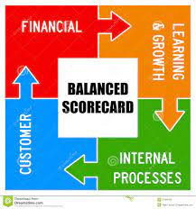
Main message : finance is a means, not an end
It all starts with « Learning and Growth ».
Learning enables improvements in Internal Processes. These better ways of working have an impact on Customer satisfaction and thus on Financial results.
It is a continuous dynamic model: each time it delivers Financial returns, the question of Learning & Growth sets off a new cycle.

Slide 25

Let’s watch
As work gets more complex 6 rules to simplify | Yves Morieux | TED@BCG
https://www.ted.com/talks/yves_morieux_as_work_gets_more_complex_6_rules_to_simplify
Make notes of the main points that interested you and formulate questions you have.

Slide 26

Feedback ?
Your reaction after this session 3 :
“WWW” – What Worked Well
“EBI” – Even Better If

